Slide 1
2025 AIDS targets Technical meeting on prevention
Short summary

Slide 2
Objectives of this meeting
To discuss what an ambitious AIDS response contains on prevention for the 2021-2030 period
To propose targets for primary prevention programmes for 2025
To propose if and how overall targets may differ for: countries, age/gender groups, population groups - including key populations
To discuss how enabling factors interact with prevention programmes and which specific enablers should be part of HIV prevention programmes, the wider HIV response and overall social development response.
To discuss bundling of primary prevention HIV services including with testing and treatment services and integration with other health services.

Slide 3
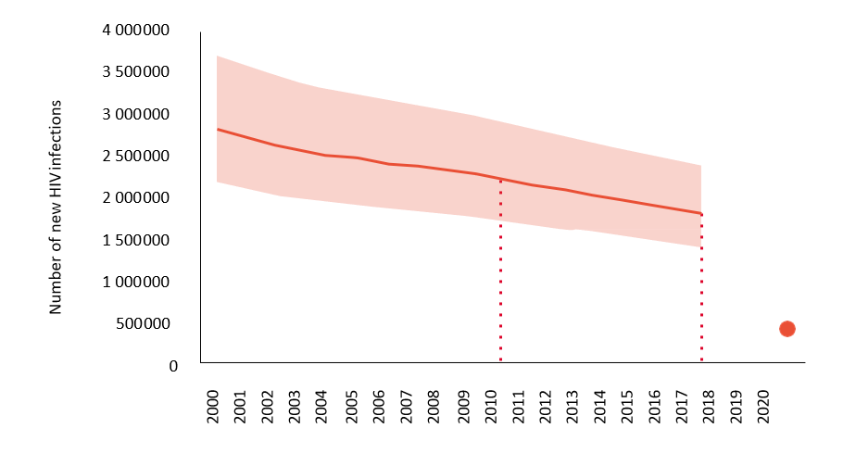
Current situation
Differential achievement by region (and by population)
Off track globally
“How to bend that incidence curve down?”

Slide 4
Achieving impact
Potential for impact is directly related to the level of risk/incidence within a particular population.
“Well-socialized” key populations vs marginalized key populations
The big picture is population-level impact and making the best use of limited resources.
Need to translate a complex reality into simple global targets.
But must also be mindful of individual-level impact.
e.g. If someone feels a need and wants PrEP, let them have it.
Need to ensure that aspirational global targets are translated nationally and locally based on local contexts.
Community-led service delivery is key.
AGYW & ABYM (high-prev settings)
MSM
Transgender people
Sex workers
+25 women and men (in high-prev settings)
People who inject drugs
Prisoners

Slide 5
Combination approach
Condoms
VMMC
PrEP
Cash transfers
PEP
HIV prevention requires a context-specific, combination approach that includes behavioural, biomedical and structural components.
Biomedical interventions are also behavioural, societal and cultural.
Importance of demand creation and trust.
Viral suppression is an HIV prevention method (U=U).
HIV testing is an HIV prevention opportunity.
Comprehensive sexuality education and economic empowerment are HIV prevention interventions for adolescents and young people.
Comprehensive packages of services have been defined and refined for each population at high risk of HIV acquisition.
WHO guidelines
SWIT, I-DUIT, TRANSIT, etc
DREAMS package

Slide 6
Integration
Key considerations
Is integration better for the client?
Will integration achieve economies of scale and/or scope?
Need to include STI prevention, screening and treatment.
Inconsistent effort to address STIs within HIV prevention programmes. A missed opportunity.
Other integration issues raised:
TB screening for prisoners and transgender people
Family planning and SRH services
HPV and cervical cancer
Tetanus vaccine and VMMC

Slide 7
Heterogeneity among sub-populations
Risk of HIV acquisition within sub-populations can vary greatly depending on individual risk behaviours
How to focus country and sub-national efforts on delivering a package of services to the populations and locations with highest HIV risk?
Prevention platforms for individual communities?
Individuals within the communities would choose from the options provided by the platform (e.g. condoms or PrEP).
Hierarchies within packages? (e.g. For PWID, NSP is more important than PrEP)
“What we need to measure is how many people at risk are protecting themselves with an effective intervention.”

Slide 8
Innovations
Door-to-door, community-based approaches have been shown to increase impact (e.g. PopART)
Dapivirine ring could be approved for PrEP among women before the end of 2020
Also in the pipeline
Additional formulations of oral PrEP
Long-acting, injectable ARVs could emerge by 2022.
Implantable forms of PrEP, broadly neutralizing antibodies and an HIV vaccine could be available by 2025

Slide 9
Critical enablers
We do not want to limit ourselves to interventions that directly create impact.
Need targets that encourage countries to address structural barriers.
Reform punitive laws and policies (criminalization, consent laws, etc)
Social protection
Education and economic empowerment
Addressing gender-based power imbalances and gender-based violence
Must address stigma and discrimination, especially in health-care settings
What works for key populations?
Community empowerment
Community-led research and services
Tailored health and human rights services
Social protection
Mental health services
Inclusion
“Getting people a job, decent clothes and a place to stay has made a huge difference in viral suppression rates in our clinic.”

Slide 10
Group work
Groups were convened to propose intervention packages, targets, sub-populations for differentiated targets and critical enablers for the following:
Gay men and other men who have sex with men
Transgender people
Sex workers
People who inject drugs
Prisoners
Adolescent girls and young women (aged 15-24 years) in high-prevalence settings
Adolescent boys and young men (aged 15-24 years) in high-prevalence settings
The inputs from the group are being integrated into the model for the 2025 targets being developed by Avenir

